Slide 2
what is iBUILD?
introduction
03

Slide 3
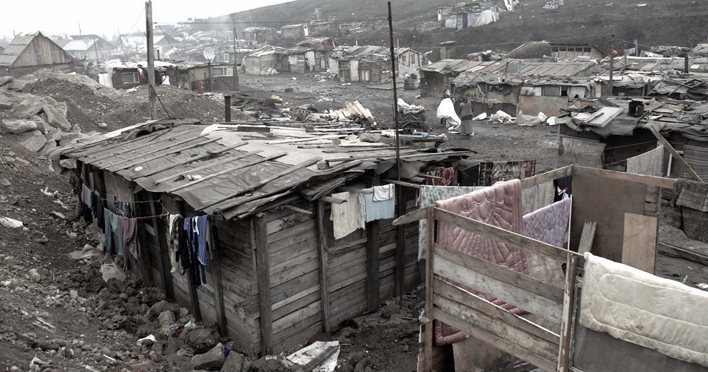
a global housing shortage
The global housing shortage is in a dire state in developing countries, where over 330 million households lack secure, affordable housing.
Organizations such as The World Bank, Habitat for Humanity, The International Monetary Fund, UN Habitat, and the International Finance Corporation are investing billions annually trying to solve this problem.
Also, individual homeowners are struggling to build housing.
What is ibuild?

Slide 4
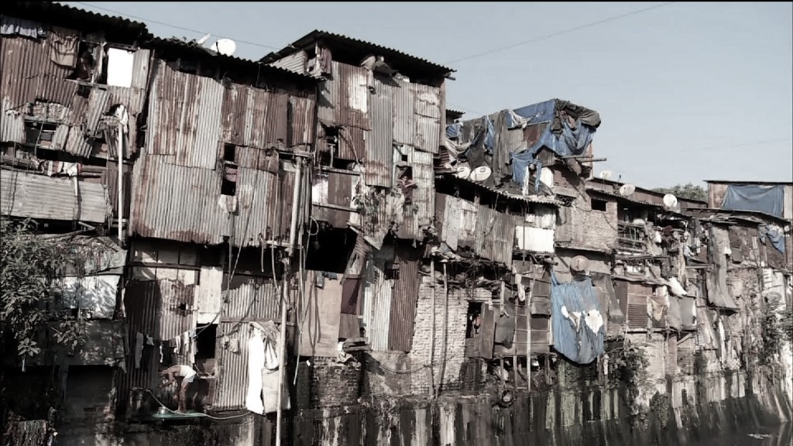
a massive problem
The cash economy
Everything in the construction ecosystem is paid for with cash: supplies, contractors, workers.
No discovery, no curation: no Yelp!, Angie’s List, etc.
No credit history so no mortgages, incremental building
FRAUD, GRAFT, and SUPPLY THEFT
It is estimated that for every $1 invested in housing only $0.55 in real housing is built often resulting in sub-standard housing.
What is ibuild?

Slide 5
our solution
The key to solving the problem is tracking the money flow. This includes money from the international agency, government, and financial institution all the way to the contractor, supplier, and worker. Until now, this has been absolutely impossible.
iBUILD is a powerful smartphone-based platform that seamlessly tracks and facilitates the flow of money through the entire construction ecosystem.
iBUILD is the first true end-to-end solution providing value for entities such as The World Bank, Habitat for Humanity, and governments, as well as all participants along the supply chain, including the day-laborers who build the houses.
“iBUILD is an innovative tool to connect builders with individuals and lenders. It is poised to bring more transparency to the market for construction and building materials.”
Friedemann Roy
Global Product Lead Housing Finance
IFC – Retail Finance – Financial Institutions Group
What is ibuild?
Notes:
supplierS workerS
ecosystem

Slide 6
A quick look at our app
03

Slide 7
What is ibuild?

Slide 8
What is ibuild?

Slide 9
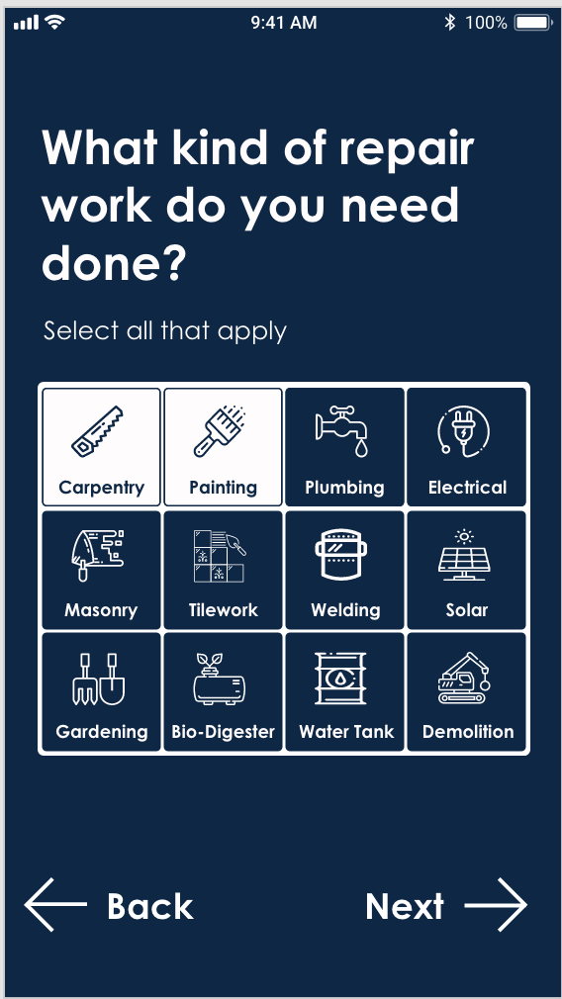
What is ibuild?

Slide 10
how does the business model work?
03

Slide 11
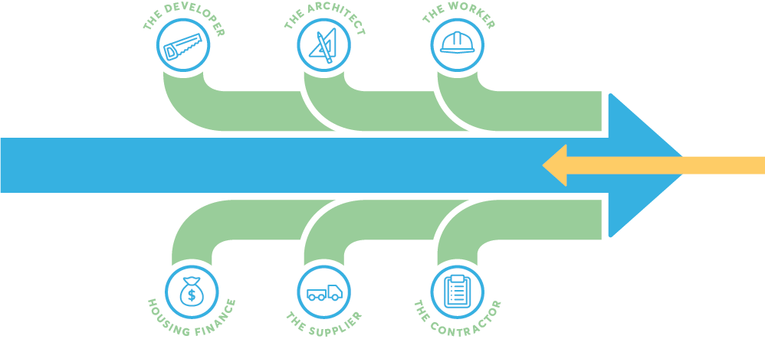
top down, bottom up
We are the trusted platform that allows all housing construction stakeholders to interact and transact. The iBUILD platform provides transaction history and big data across this shared ecosystem.
large scale construction
design
labor
Governments*
large funds institutions agencies
subsidy & finance
Self-BUILD DEMAND**
developer & consumer lending
materials
management
Developing Country Housing Supply
* Gov’t built & commercial housing starts: 30%
**Self-built housing starts: 70%
how does it work?
Notes:
Red is not good

Slide 12
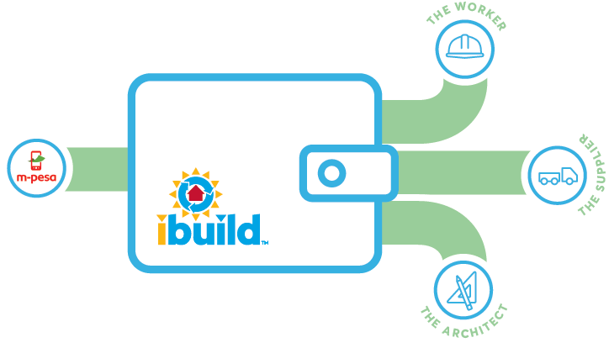
iBUILD wallet
The iBUILD™ solution centers on an embedded electronic wallet that is easily integrated within leading mobile payment providers and banking systems. The wallet allows payment and transaction tracking throughout project life-cycle, through verifiable, geo-tagged milestones, all within a secure, efficient, accountable, transparent cloud-based platform.
iBUILD™ Analytics:
1
Data from wallet transactions measure previously untraceable marketplace activity
Data from platform registrations and construction project activity inform governments and lenders of the # of units constructed, cost of projects, # housing starts, project geographies, and registrant demographics
contractor
2
consumer
how does it work?
Notes:
Point 2 starting w #

Slide 13
sources of income
B2C
C2C
job postings
Big data
job applying
Banks – Credit scoring
project posting
Advertising of Services
training
total of 6%
supplier advertising
architect programs
advertising to workers
Supplier logistics
how does it work?

Slide 14
We’ve got problems!
03

Slide 15
just two for starters
Access to credit for the middle class
Handling product ontologies from many suppliers
What is ibuild?

Slide 16
underwriting
How to improve access to credit for the un(der-)banked?
Most people in in developing countries don’t have bank accounts
Banks don’t give (reasonable) mortgages (see: “cash economy”)
What is ibuild?

Slide 17
current solutions…
Micro-lenders typically
Lend US$2-300
Term is a month,
For a fee of ~15%
This is an annualized rate of 2-400%
Can we do better?
Based on:
Cell phone type and location (home, work)
SMS messages (financial transactions)
What is ibuild?

Slide 18
our approach
We specialize in loans to individuals associated with housing construction
Not just homeowners: suppliers, contractors, workers too
We have lots of data!
What supplies have they bought?
Do they buy expensive supplies?
Are contractors paid on time, on a regular cadence?
What is ibuild?

Slide 19
supplier ontologies
What is ibuild?

Slide 20
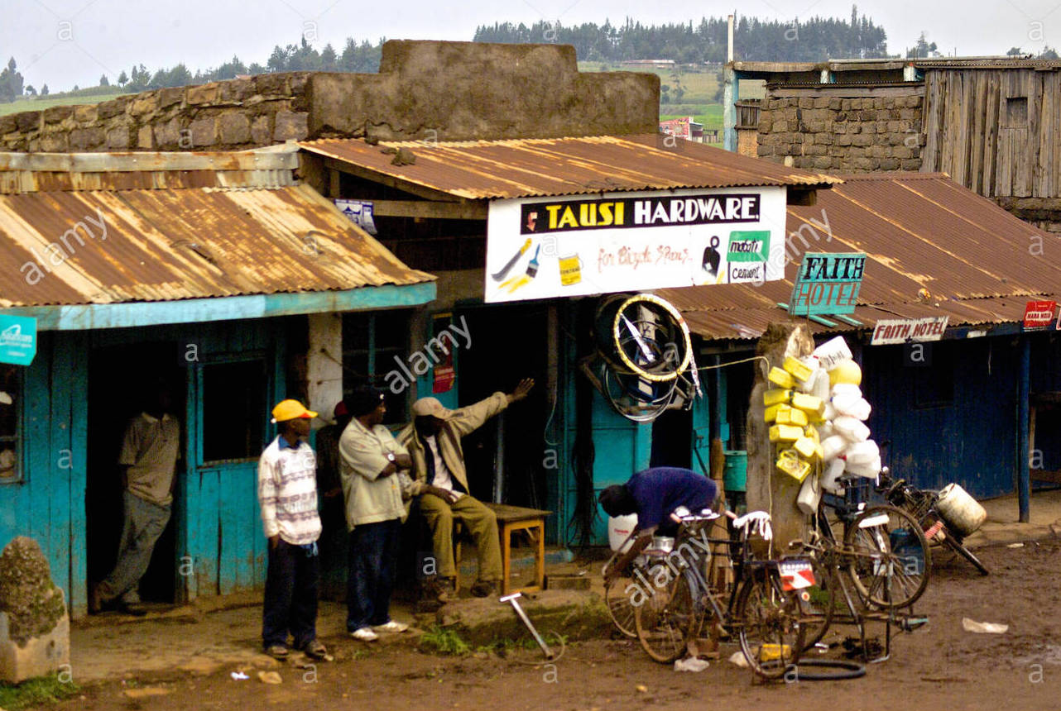
we have to handle this…
What is ibuild?

Slide 21
…and this…
What is ibuild?

Slide 22
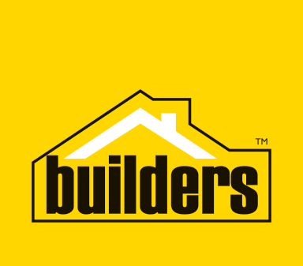
Handling disparate ontologies…
Mom-and-pop hardware stores vs. Builders Warehouse
How to easily onboard small non-computer-savvy stores?
Auto-categorization of images?
Merging ontologies
How to provide a good customer experience?
Searching and explicit navigation through the classes
The Chimaera Ontology Environment, McGuinness, Fikes, Rice, & Wilder, AAAI 2000.
GTIN
What is ibuild?

Slide 23
data products
Need to programmatically do inferences on our (lightweight) ontology
Can we predict near-future demand for particular product categories in particular locations?
Generalization over stores, locations and time
Sparsity at category- or product-level
Promote similar products?
Would you like some this with that?
What is ibuild?

Slide 24
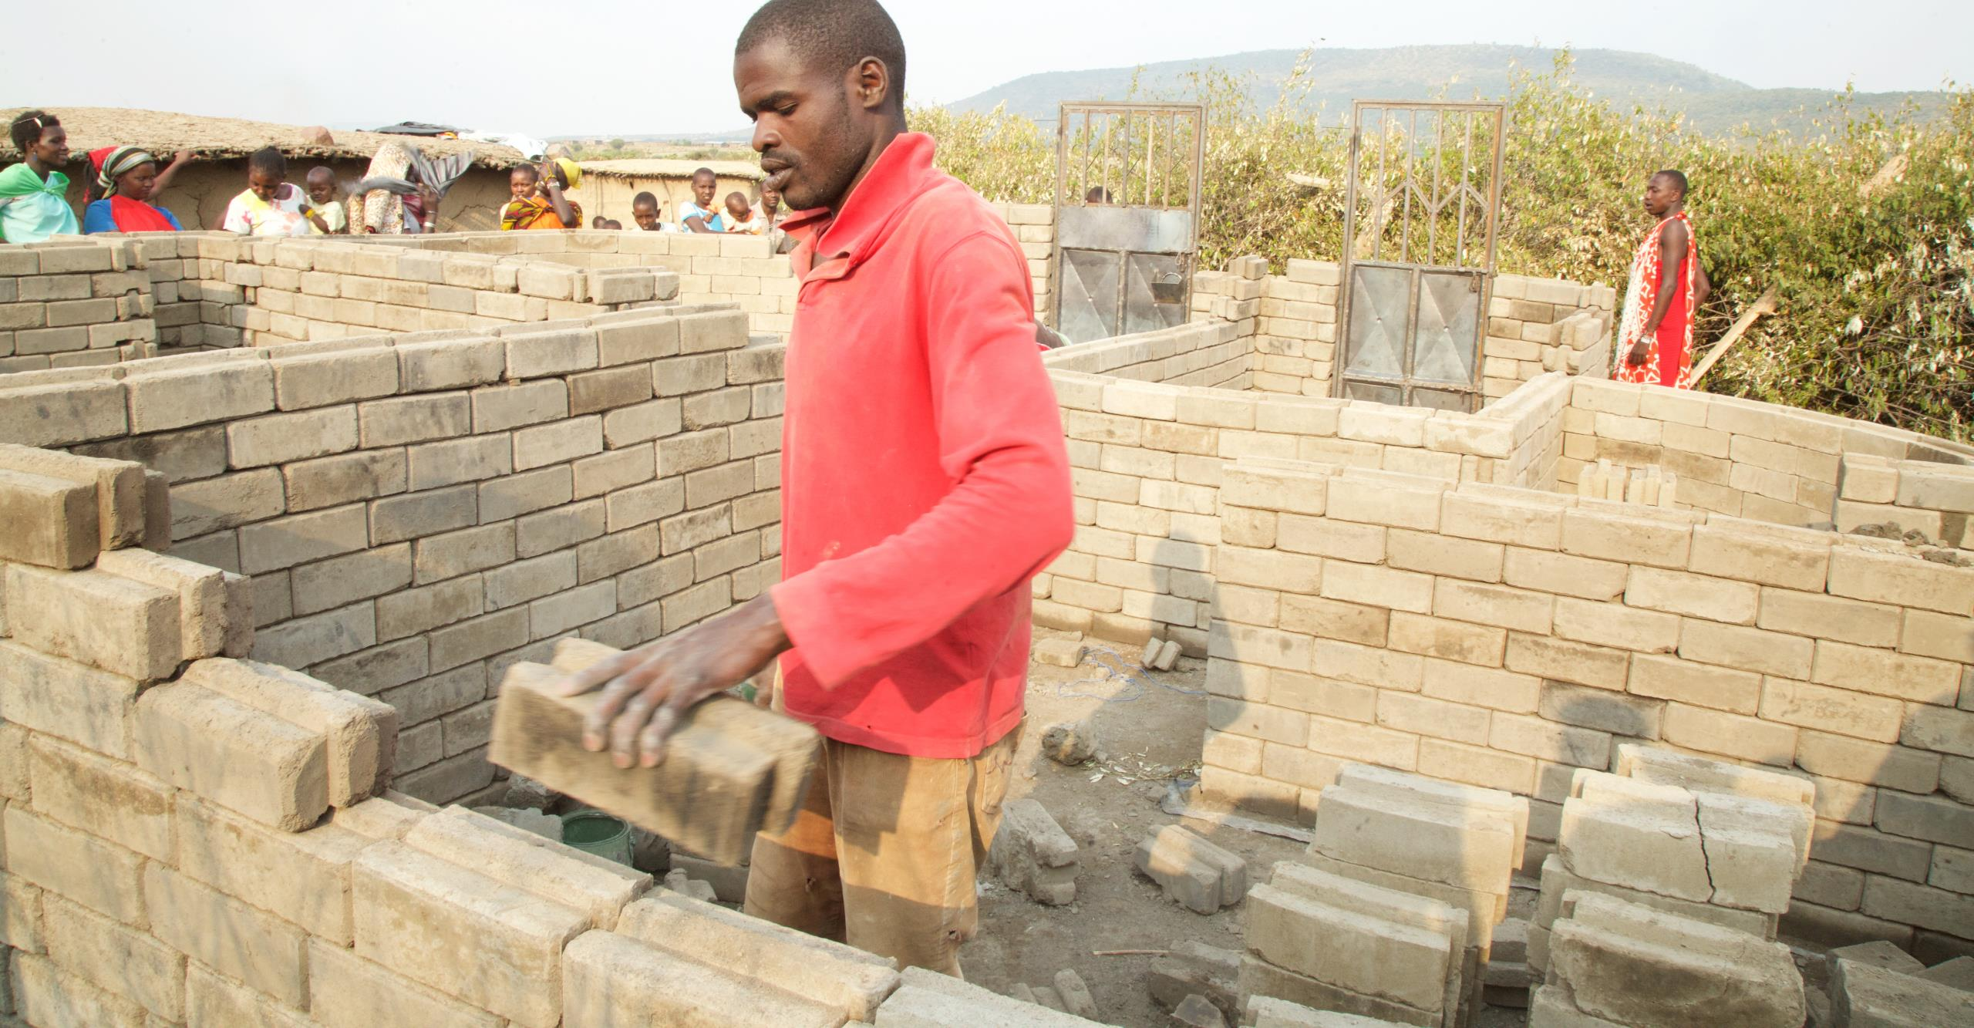
summary
iBUILD is an industry-changing platform bringing transparency and order to the construction ecosystem to unleash huge amounts of latent building capital.
what drives success?

Slide 25
thank you

